Slide 1
STUDENT PERFORMANCE
T5
Fernanda, Bernardo, Valentina

Slide 2
Did you know...
“Weak statistical relation between student time devoted to learning and average achievement scores”.
“Pre-Schooling: probably beneficial for later academic achievement”.
“Increased instruction and homework time is not a simple solution”.
“More support to single-parent families is likely to have positive effects”.
“Benefits in focusing on the reading performance of boys”.
“Potential benefits in focusing on the Math and Science performance of girls”.
“Self-confidence and anxiety Matter More”.

Slide 3
Our Data Set
Family Educational Support
Extra paid classes
Extra-curricular Activities
Attended Nursery School
Wants to take Higher Education
Internet access
In a Relationship
Family Relationship
Free time
Time going out
Weekend alcohol consumption
Health status
Number of school absences
Period 1 Grade Period 2 Grade
Final Grade
Parameters:
Gender
Age
Home address type
Family size
Parents cohabitation status
Reason to choose this school
Student’s guardian
Travel time
Weekly study time
Number of past failures
Extra educational support

Slide 4

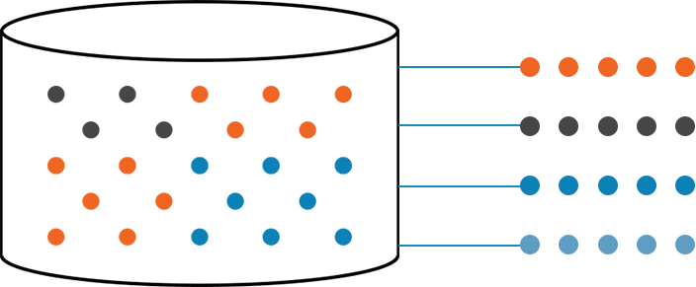
Cleaning the Data
SCALING
Our data had many different types of numerical scales.
We used scaling so that features with large values won't take priority over others.

Slide 5

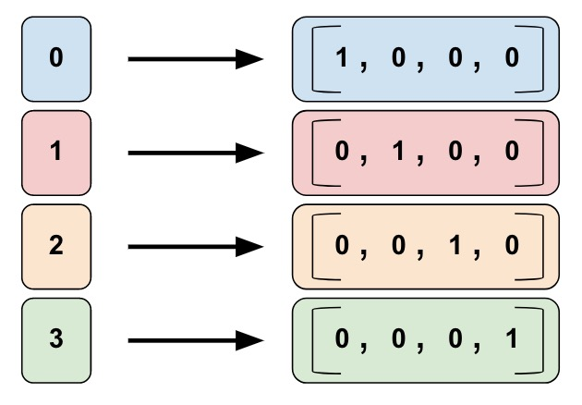
Cleaning the Data
BINARY FEATURES
“Yes” and “no” binary features into 0’s and 1’s
ONE HOT ENCODING
Categorical values into binary

Slide 6
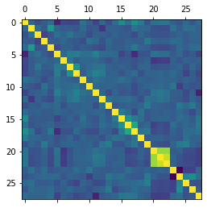
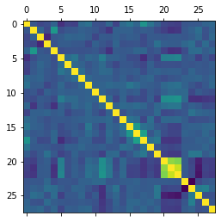
Correlation matrix
Math
Portuguese

Slide 7
Model accuracy for Math
MODEL | ACCURACY (all features) | ACCURACY (without G1 & G2)
Naive Bayes | 80.5% | 51.4%
Random Forest Classifier | 92.4% | 61.5%
KNeighbors Classifier | 92.9% | 55.7%
MODEL | ACCURACY (all features) | ACCURACY (without G1 & G2)
Naive Bayes | 80.5% | 51.4%
Random Forest Classifier | 92.4% | 61.5%
KNeighbors Classifier | 92.9% | 55.7%

Slide 8
Model accuracy for Portuguese
MODEL | ACCURACY (all features) | ACCURACY (without G1 & G2)
Naive Bayes | 71.8% | 70.7%
Random Forest Classifier | 92.3% | 68.9%
KNeighbors Classifier | 92.8% | 66.1%
MODEL | ACCURACY (all features) | ACCURACY (without G1 & G2)
Naive Bayes | 71.8% | 70.7%
Random Forest Classifier | 92.3% | 68.9%
KNeighbors Classifier | 92.8% | 66.1%

Slide 9
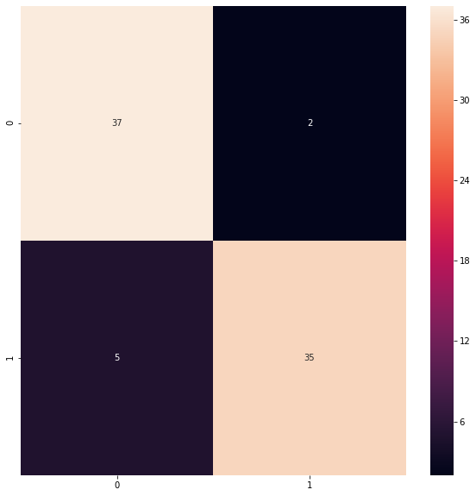
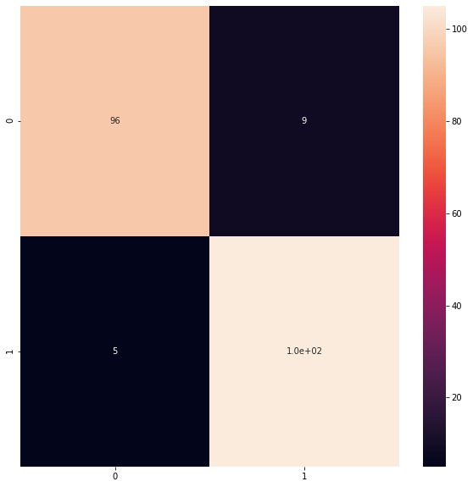
Confusion Matrix
Math
Portuguese

Slide 10
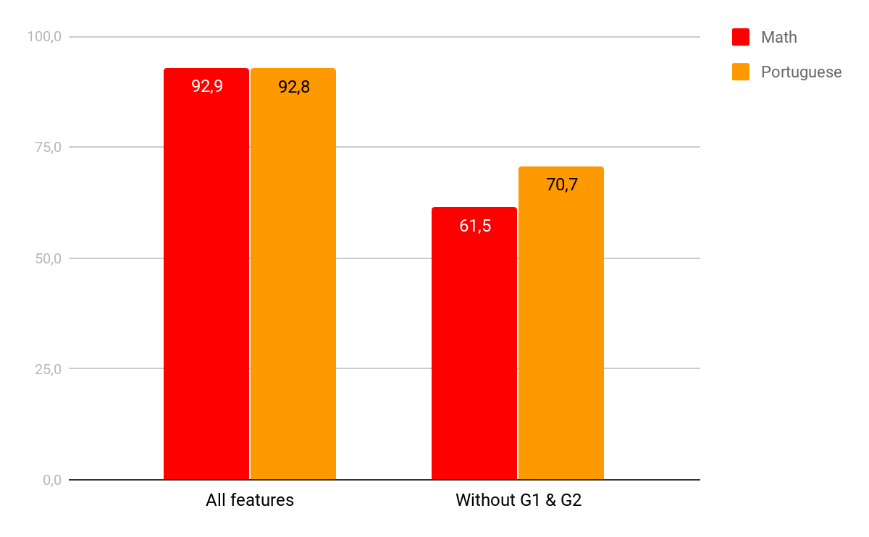
Comparing Math with Portuguese

Slide 11




Most important features
G1 & G2
'Grade_dif', 'Higher', 'Pstatus'
'Famsup', 'Studytime', 'Nursery', 'Pstatus', 'Activities'
Math
→ 93.9%
→ 61.5%
→ 53.9%
Portuguese
→ 93.8%
→ 62.6 %
→ 60.9%

Slide 12
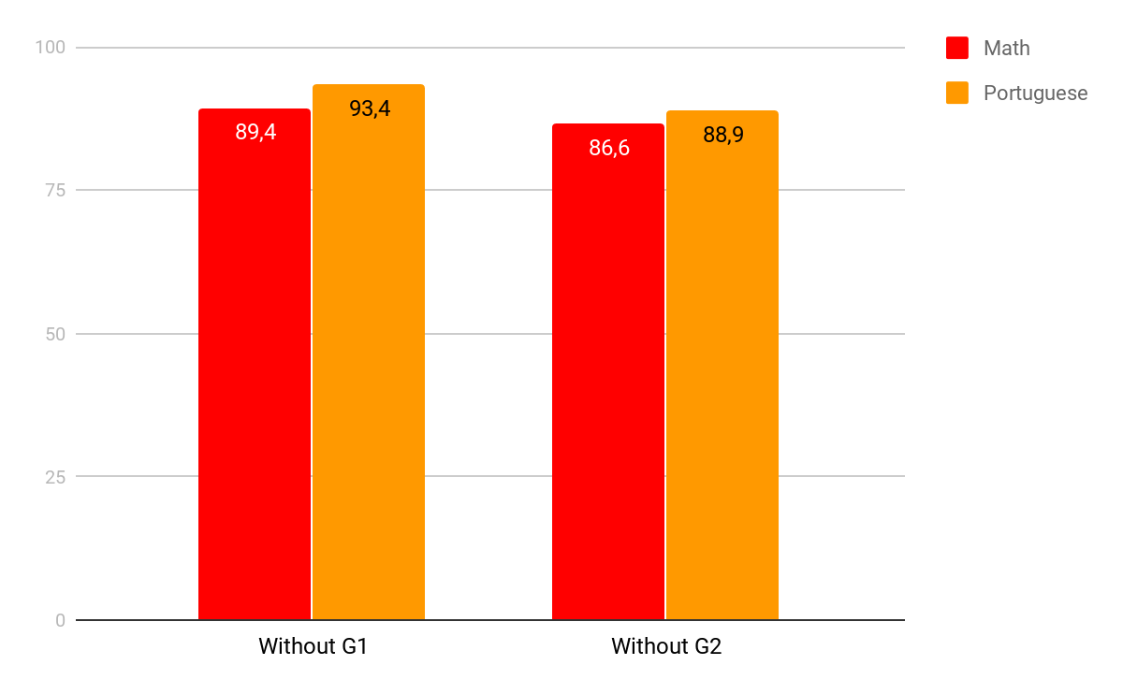
Influence of grades

Slide 13
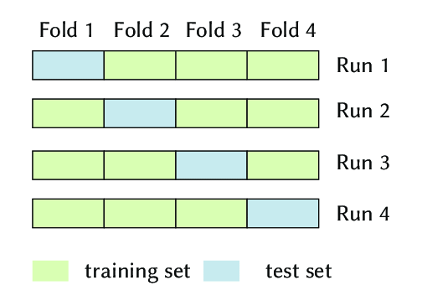
The Cross-Validation Technique
Before CV:
Math (Naive Bayes) - 92.4%
Portuguese (KNeighbors) - 92.1%
After CV:
Math (Naive Bayes) - 80.5%
Portuguese (KNeighbors) - 92.8%
After CV:
Math (Naive Bayes) - 80.5%
Portuguese (KNeighbors) - 92.8%

Slide 14
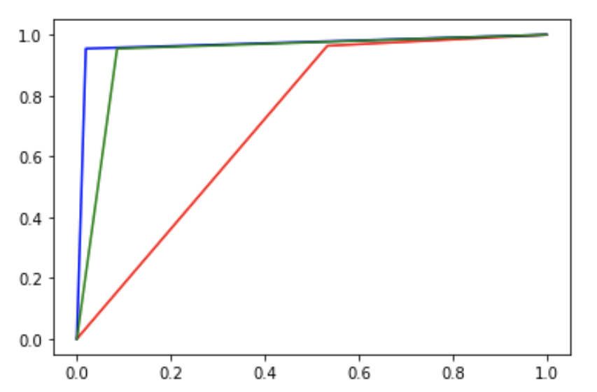
ROC curves
Red → Naive Bayes
Blue → Random Forest
Green → KNeighbors
A measurement of the usefulness of tests.
Math
Portuguese

Slide 15


Observations
Limited data set
Different subjects would have complemented our data
Portuguese and Math grades belonged to different students
Comparing our data set with previous studies

Slide 16
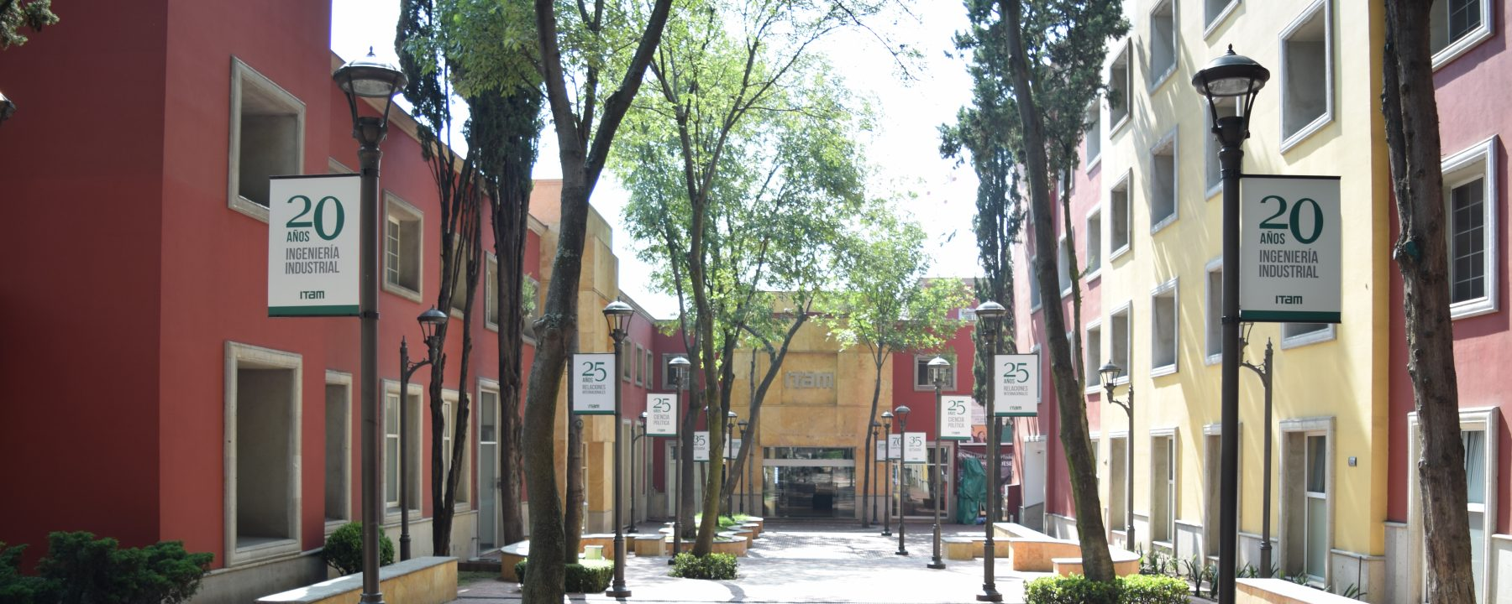
Implications
Why is this useful?
Helping students perform better
Helping schools educate better
ITAM
Grades in ITAM do not necessarily reflect the level of education because of the difficulty level is higher
Apply this model with data from ITAM → improve overall performance.

Slide 17

Takeaway

Slide 18
References
From: Danish Technological Institute “Explaining Student Performance”
Evidence from the international PISA, TIMSS and PIRLS surveys, November 2005
http://www.oecd.org/education/school/programmeforinternationalstudentassessmentpisa/35920726.pdf
https://archive.ics.uci.edu/ml/datasets/Student+Performance

